Slide 1
Firewalls and Security Protocols

Slide 2
Today’s Plan
9:00 – 9:15: Review Python activities.
9:15 – 10:00: Mark Stamp, Information Security Principles and Practices [Chapters 8 and 10], Second Edition, Wiley, USA.
Firewalls
Security Protocols
SSH
SSL
10:00 – 11:00: Demo.
11:00 – 12:00: Lab 6 (Firewalls and SSH in Linux).

Slide 3
Firewalls

Slide 4

Firewalls
The secretary of the network.
Examines requests for access to your network.
Positioned between your network and the internet.

Slide 5
Types of Firewalls
Packet Filter: Operates at the network layer.
Stateful Packet Filter: Operates at the transport layer.
Application proxy: Operates at the application layer.

Slide 6
Packet Filter
Filters based on:
Source IP address.
Destination IP address.
Source port.
Destination port.
TCP flags (SYN, ACK, RST, …)
Filters based on ingress and egress.
Configured using ACLs.
Pros:
Efficiency.
Cons:
Each packet is treated independently.
Can’t examine a TCP connection.
Blind to viruses and malware.
?
Notes:
-Packet filters really operate in layer 4 but they don’t understand it!
-These ACLs are different from the ones seen in file sharing!

Slide 7
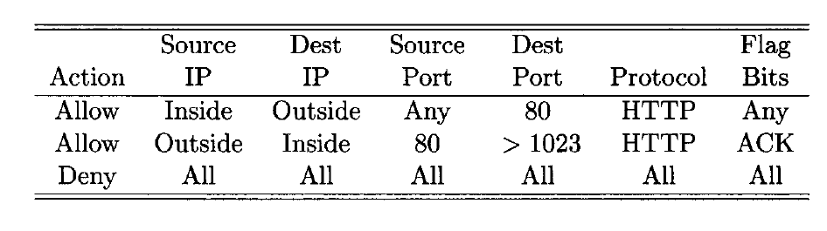
ACLs for Packet Filtering
1
2
3
Notes:
-The purpose of this ACL is to restrict incoming packets to Web response (port 80).
It allows all outbound Web traffic (port 80).
It allows all inbound Web traffic (port 80) to any destination port larger than 1023 (TCP/UDP) as long as it carries the ACK (acknowledgement) TCP flag.
All other traffic is forbidden.

Slide 8
Attack on a Packet Filtering (TCP ACK)
Port scan:
Send a packet with ACK bit set (even if such thing violates the TCP 3-way handshake protocol).
A host receiving this packet will respond with a RST packet to terminate the connection.
If the attacker receives a RST packet, then such port is open.
Prevented by using stateful packet filters:
Remembers TCP and UDP connections.
Slower processing, still not aware of viruses/malware.

Slide 9
Application Proxy
Proxy: Something that acts on your behalf.
The firewall, acting on the user’s behalf, is able to verify that the packet is legitimate and that the content is safe.
When a packet passes through the firewall, the incoming one is destroyed and a new one is created in place.
This avoids TCP ACK attacks since the attacker will not receive time exceeded responses.

Slide 10
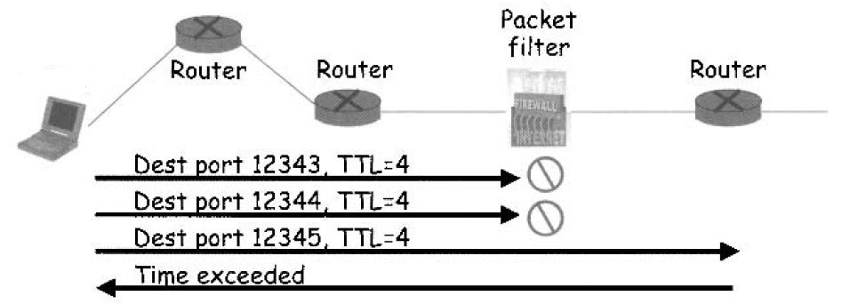
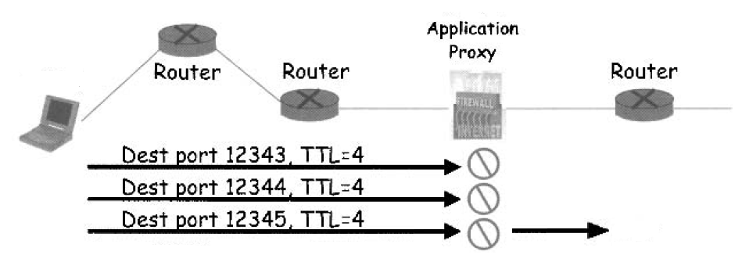

Slide 11
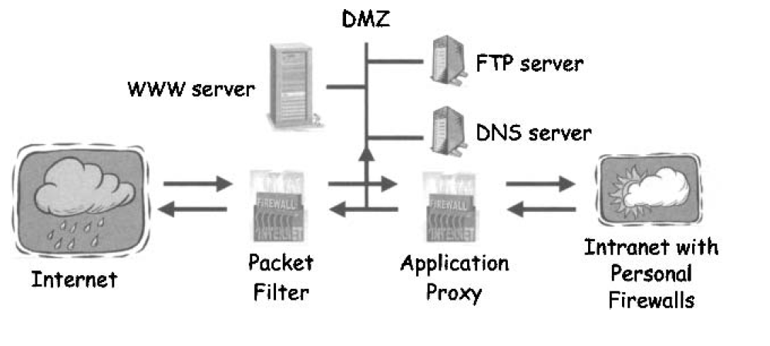
Defence-in-Depth Using Firewalls
Notes:
1.Packet filter prevents common attacks on the systems in the DMZ (those that must be exposde to the outside world).
Attacks on the DMZ will be annoying but not life threatening.
2. Since the traffic in the internal network is considerably smaller, the application proxy will be sufficient in this case.
3. Finally, personal firewalls ensure the safety of each system in the intranet.

Slide 12
Secure Shell (SSH)

Slide 13
Secure Shell (SSH)
Creates a secure tunnel used to transmit insecure commands:
UNIX rlogin to log into a remote machine.
Ubuntu ssh command.
Once the SSH connection is established, such login typically only requires a password sent in the clear.
Sending this password through SSH will secure that password from sniffers.
Based on:
Public key cryptography (Diffie-Hellman, RSA, …).
Digital certificates.
Hashing functions.
or
ID/Passwords.

Slide 14
Diffie-Hellmann (DH) algorithm
“Invented” by Withfield Diffie and Martin Hellman.
Public-key cryptography protocol.
Key exchanging: Allows users to establish a shared symmetric key.
Relies on the computational complexity of calculating a discrete logarithm.
Notes:
-The scheme was first published by Whitfield Diffie and Martin Hellman in 1976, but in 1997 it was revealed that James H. Ellis, Clifford Cocks, and Malcolm J. Williamson of GCHQ, the British signals intelligence agency, had previously, in 1969, shown how public-key cryptography could be achieved. (Wikipedia)

Slide 15
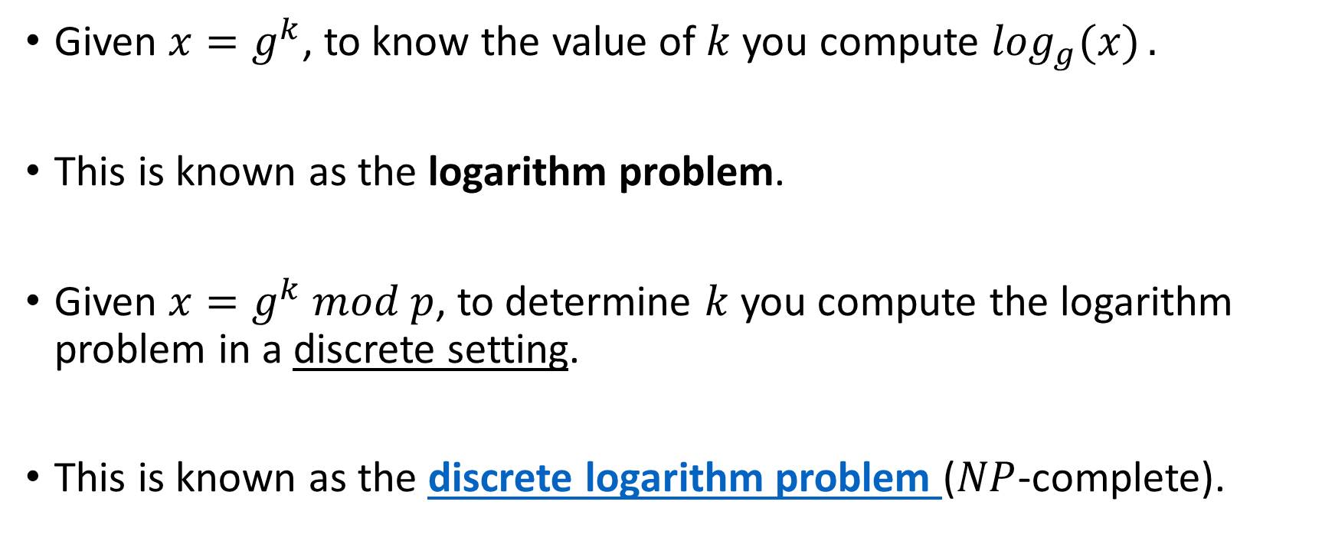
The Discrete Logarithm Problem
Given $x=g^{k}$, to know the value of $k$ you compute $\log_{g}{(x)}.$
This is known as the logarithm problem.
Given ${x=g}^{k} mod p$, to determine $k$ you compute the logarithm problem in a discrete setting.
This is known as the discrete logarithm problem ($NP$-complete).
Notes:
The hardness of the algorithm relies on the group where $g$ and $p$ have been obtained (large prime numbers).

Slide 16
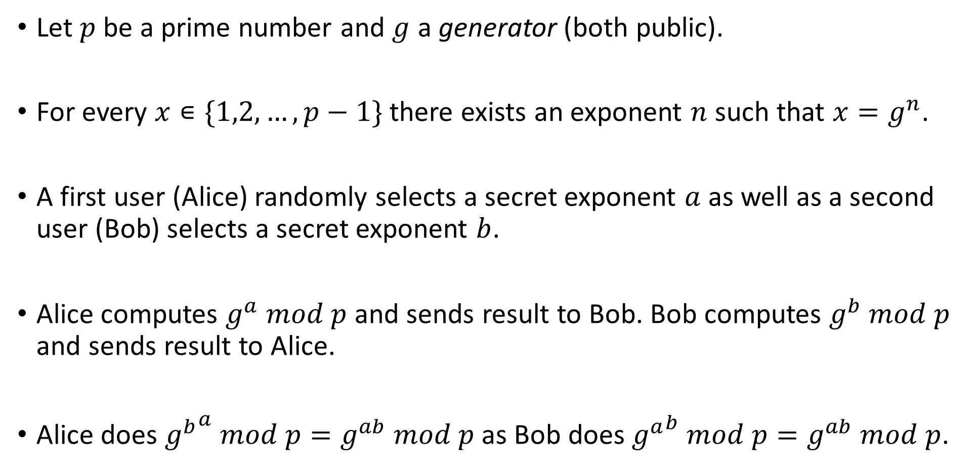
DH
Let $p$ be a prime number and $g$ a generator (both public).
For every $x∊\{1,2,…,p−1\}$ there exists an exponent $n$ such that $x=g^{n}$.
A first user (Alice) randomly selects a secret exponent $a$ as well as a second user (Bob) selects a secret exponent $b$.
Alice computes $g^{a} mod p$ and sends result to Bob. Bob computes $g^{b} mod p$ and sends result to Alice.
Alice does ${g^{b}}^{a} mod p=g^{ab} mod p$ as Bob does ${g^{a}}^{b} mod p=g^{ab} mod p$.
Notes:
-a and b are large prime numbers.

Slide 17
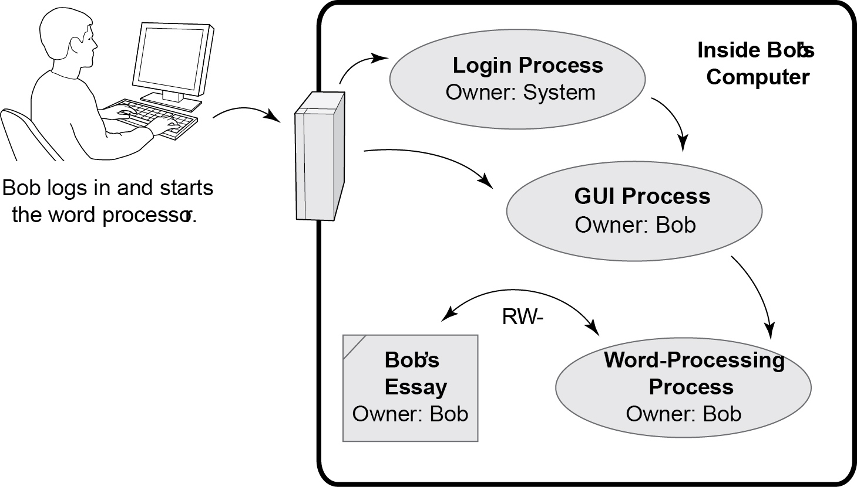
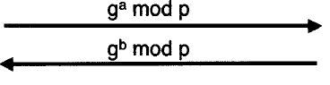
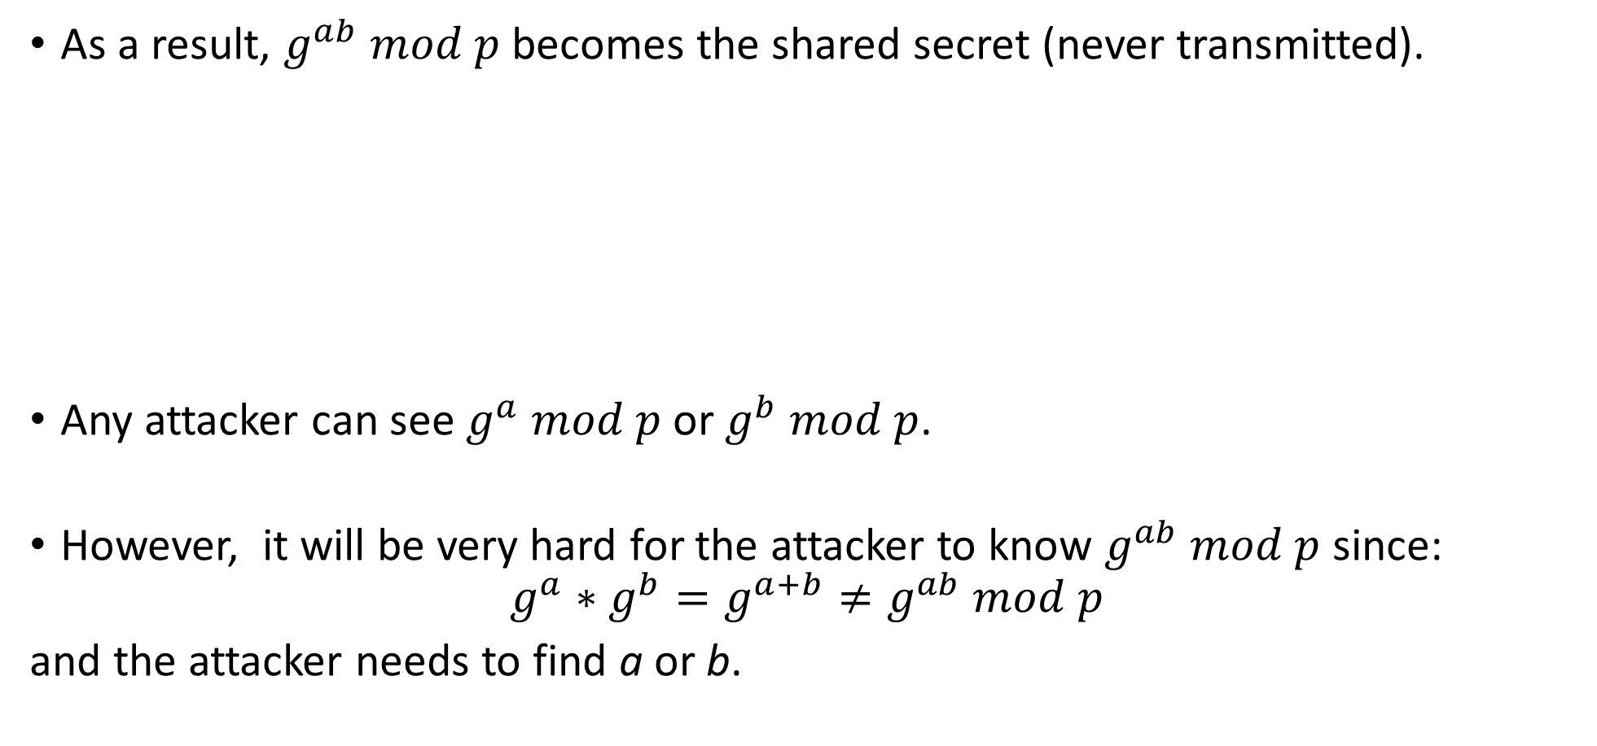
DH
As a result, $g^{ab} mod p$ becomes the shared secret (never transmitted).
Any attacker can see $g^{a} mod p$ or $g^{b} mod p$.
However, it will be very hard for the attacker to know $g^{ab} mod p$ since:
$$g^{a}∗g^{b}=g^{a+b}≠g^{ab} mod p$$
and the attacker needs to find a or b.
Alice
Bob

Slide 18

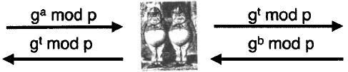
Fundamental Problem
Man-in-the-middle attack.
Solution:
Encrypt DH with shared symmetric or public key techniques.
Sign DH values.
Alice
Bob
Then why using DH?
Notes:
-DH is not used alone, it is used to only to exchange keys within other secure protocols.

Slide 19
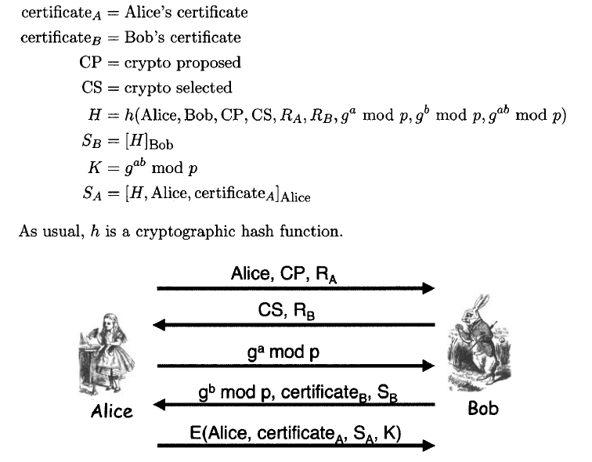
SSH (simplified)
Alice
Bob
Notes:
Alice identifies herself and sends crypto-parameters that she prefers (crypto, algorithms, keys) along with her nonce R_A.
Bob selects from Alice’s crypto params and returns his selection along with his nonce R_B.
Alice sends her DH value.
Bob responds with his DH value, his certificate and a signed hash value S_B.
With this info, Alice computes the DH key K and with it, it encrypts and sends her identity, her certificate and her signed hash value S_A.

Slide 20
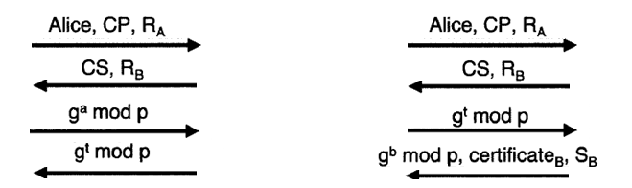
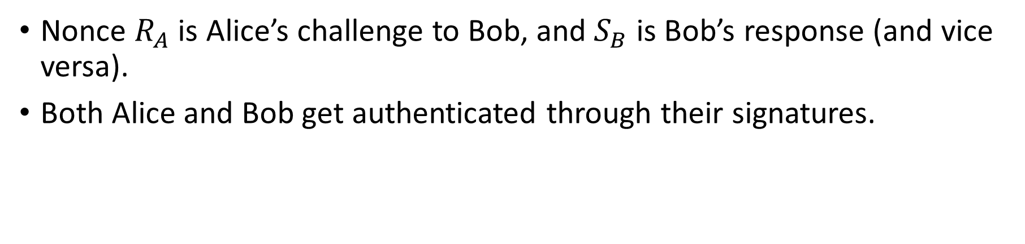
Security of SSH
Nonce $R_{A}$ is Alice’s challenge to Bob, and $S_{B}$ is Bob’s response (and vice versa).
Both Alice and Bob get authenticated through their signatures.
Will a man-in-the middle attack on the DH values compromise SSH?
Then what could?
Alice
Bob
Notes:
-No. The attacker can block step 3 and send Bob a fake DH value, however after step 4 Alice will eventually know that a fake DH value doesn’t make sense because the attacker wouldn’t know how to replicate S_B, which is the response to Alice’s nonce.
-If the attacker can replicate the certificate_B or S_B, then we have a problem!

Slide 21
Secure Socket Layer (SSL)

Slide 22
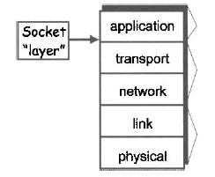
Secure Socket Layer
Socket layer between the transport and application layers.
Often deals with web browsing.
Application protocol is HTTP.
Transport protocol is TCP.
When a website is secured by SSL, it displays https.
The most current version of SSL is called Transport Layer Security (TLS).

Slide 23
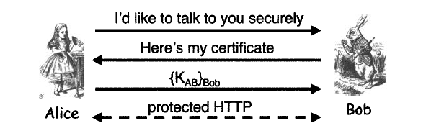
Secure Socket Layer
Preferred choice for internet transactions:
Non-mutual operation.
Security for the buyer’s detail is held by the seller once the secure connection is established.
Alice
Bob
Notes:
-You need to be sure you are dealing with Amazon, but Amazon doesn’t necessarily needs to know who you are as long as you have money.
-The basic idea of SSL doesn’t include an authentication of Bob, only the fact that “Bob” has a certificate.

Slide 24
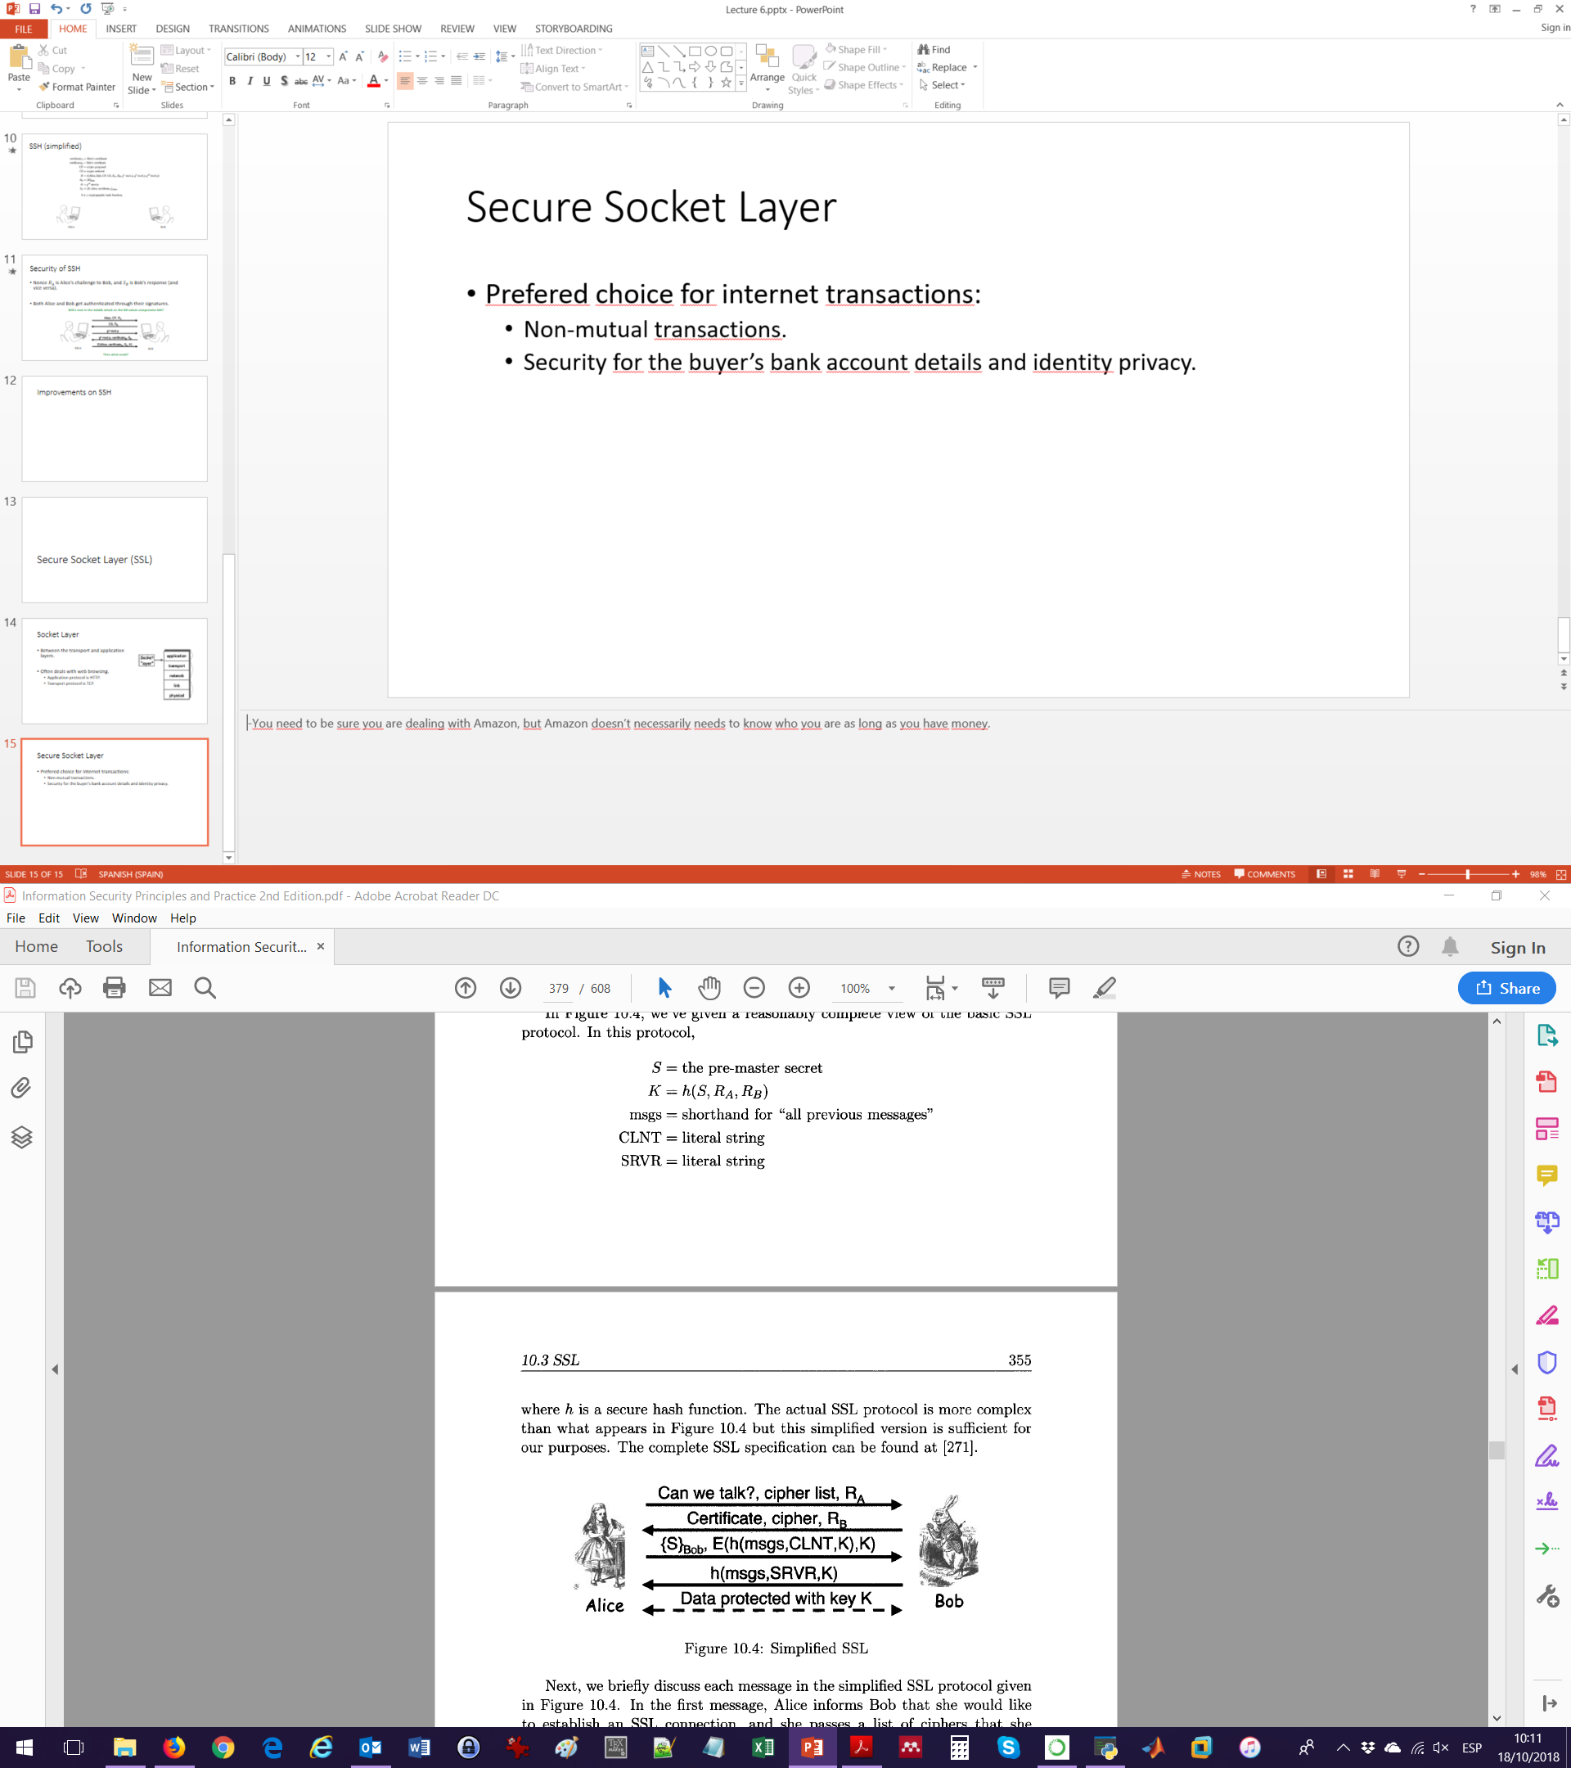
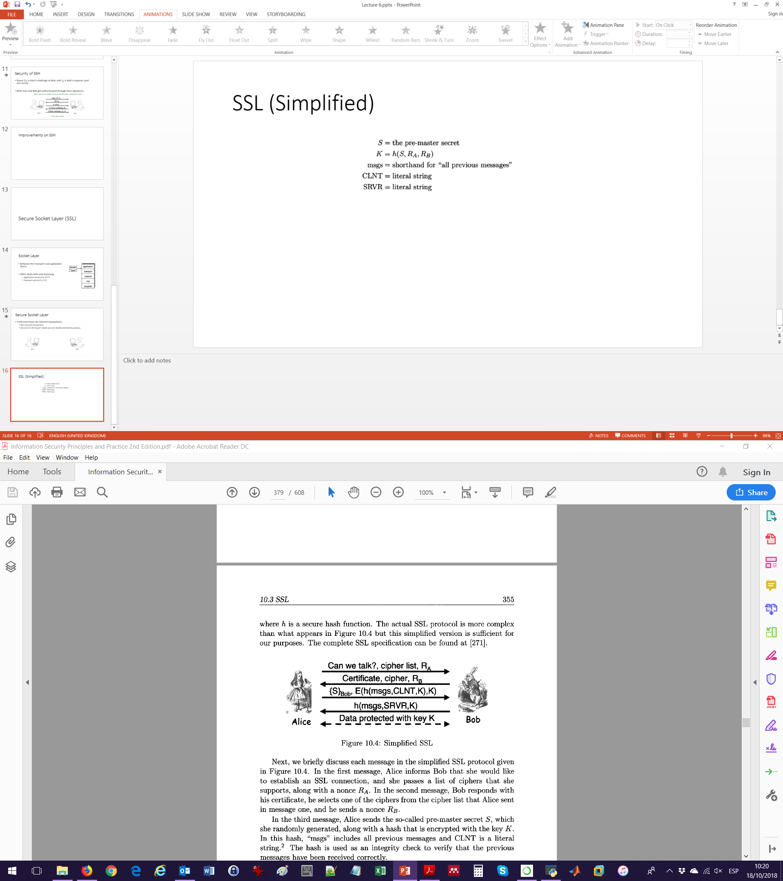
SSL (Simplified)
Alice (browser)
Bob (server)
Is Alice being authenticated by Bob?
Notes:
Alice tells Bob that she would like to establish an SSL connection, passes a list of ciphers that she supports and a nonce R_A.
Bob responds with his certificate, he selects one of the ciphers and returns his nonce R_B.
Alice sends her pre-master secret S (randomly generated through the agreed cipher, for instance DH) encrypted with Bob’s public key, along with an encryption that includes the key K (master secret). msgs and CLNT are related to the handshake. Bob decrypts {S}_Bob and can compute K himself.
Bob responds with a similar hash. By computing this hash, Alice can verify that it’s still talking to Bob, since only Bob could have decrypted {S}_Bob and thus only Bob can know K.
Alice authenticates Bob but NOT vice versa. This is not necessary because users rarely acquire certificates, but rather acquire a password to validate themselves through a secure connection).

Slide 25
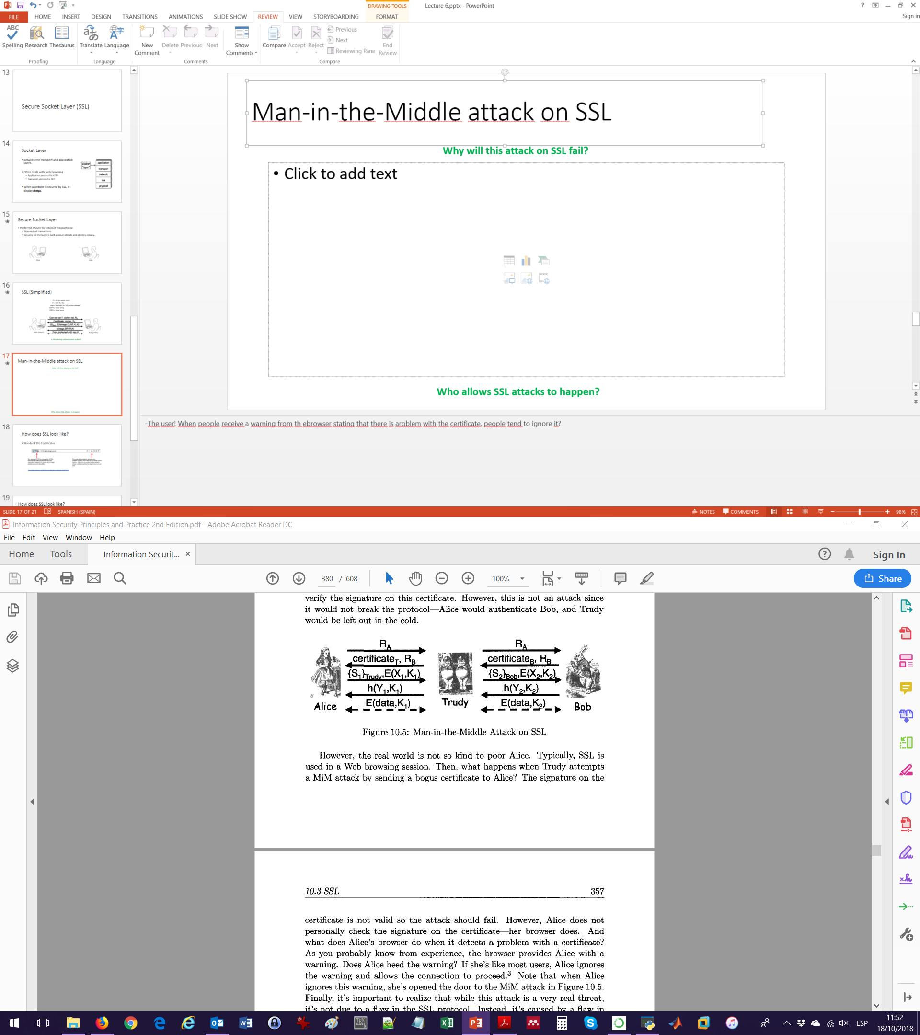
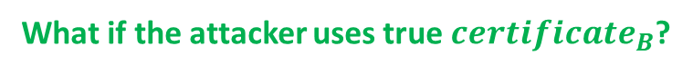
Man-in-the-Middle attack on SSL
Alice (browser)
Bob (server)
Why will this attack on SSL fail?
What if the attacker makes a false $certificate_{B′}$?
What if the attacker uses true $certificate_{B}$?
Who allows SSL attacks to happen?
Notes:
-This attack will fail in the moment that Alice checks the certificate_T with a CA and discover is false (when attempting to verify the signature on the certificate).
-Another option is that the attacker create a false certificate_B’. This will fail again when Alice tries to verify the signature of Bob’ certificate.
-Finally, if the attacker lets the true certificate pass, he is left out of SSL.
-Alice could allow attacks! When people receive a warning from the browser stating that there is a problem with the certificate, people tend to ignore it?

Slide 26
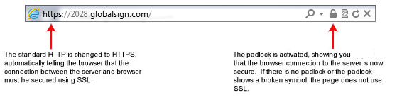
How does SSL look like?
Standard SSL Certificates
https://www.globalsign.com/en/ssl-information-center/what-is-an-ssl-certificate/

Slide 27
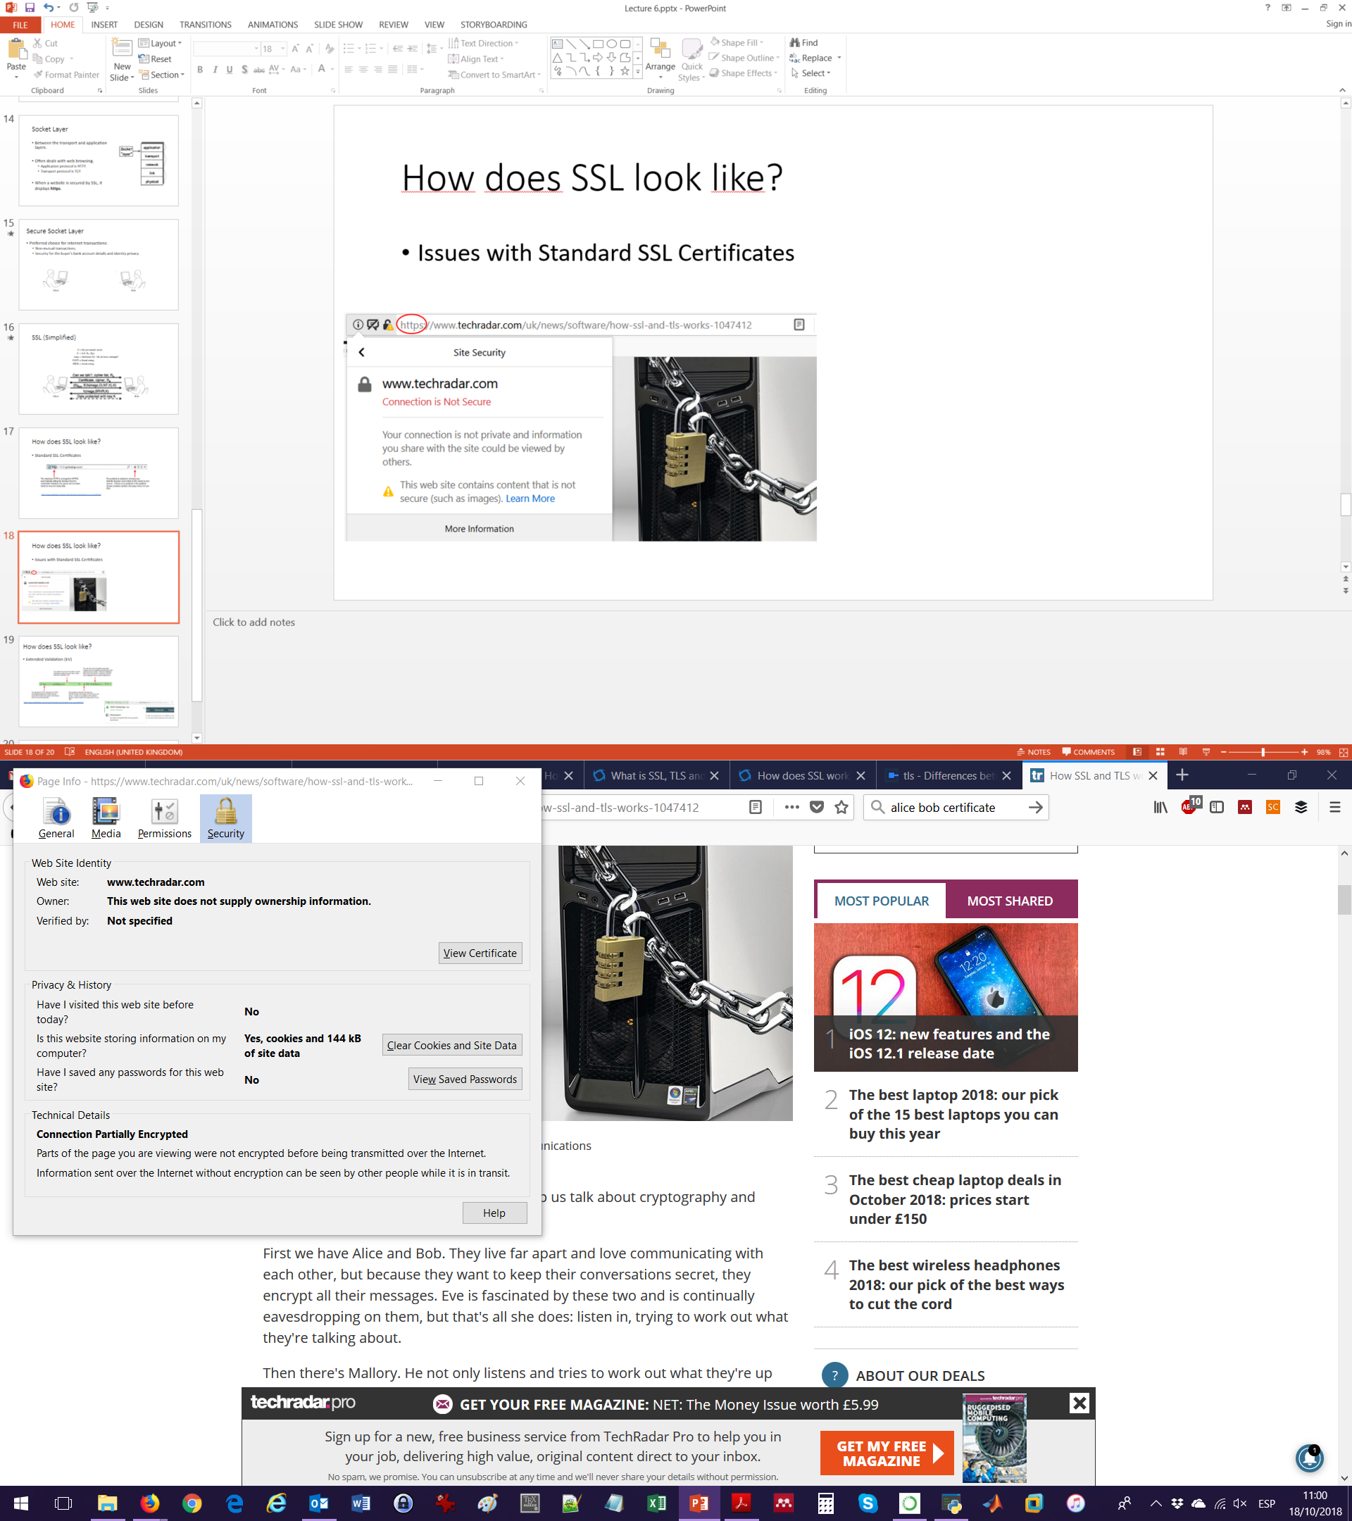
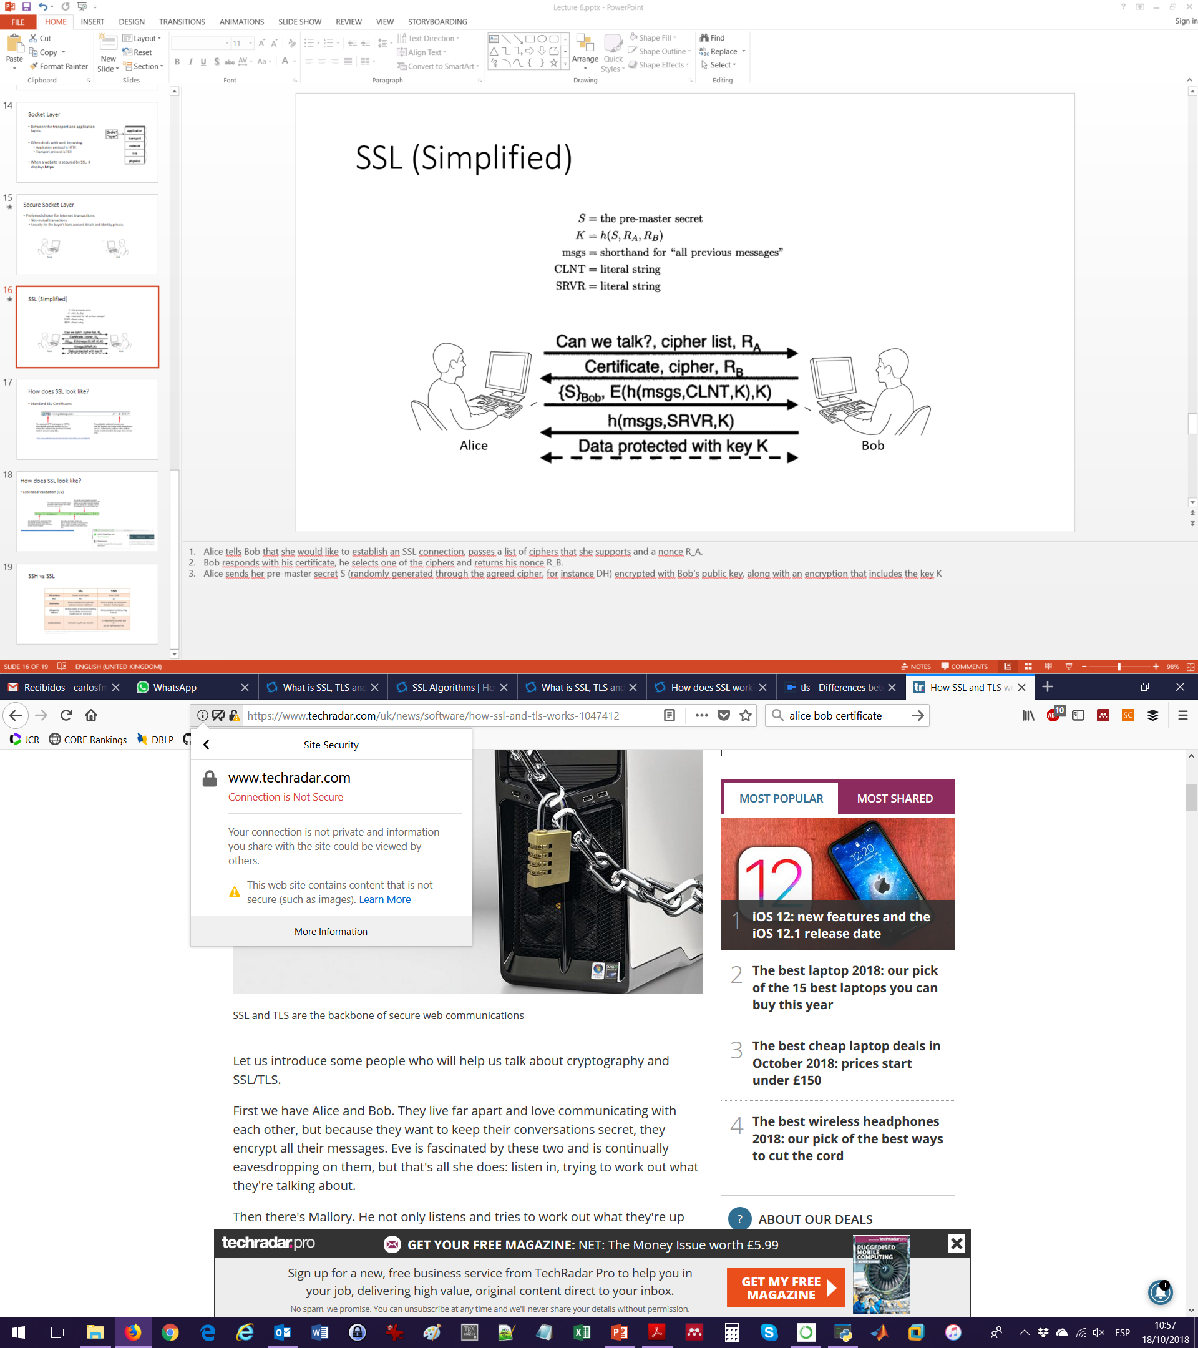
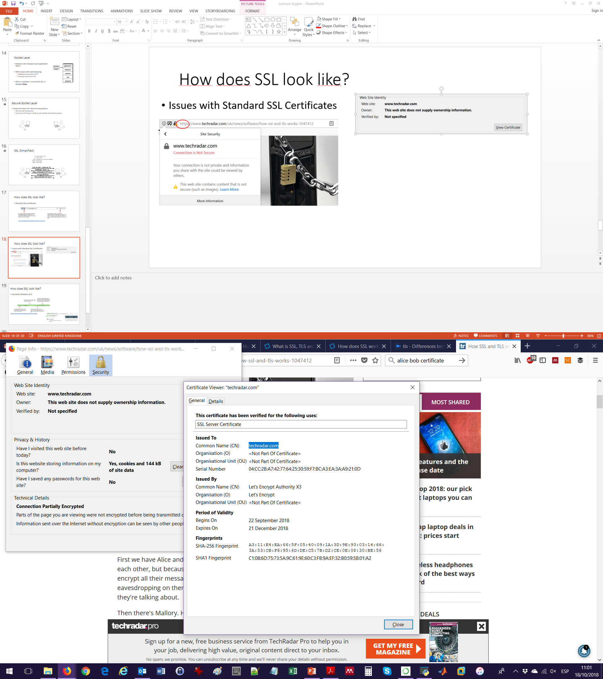
How does SSL look like?
Issues with Standard SSL Certificates

Slide 28
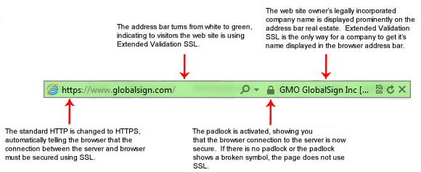
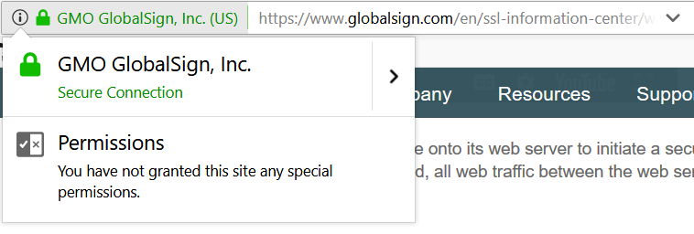
How does SSL look like?
Extended Validation (EV)
https://www.globalsign.com/en/ssl-information-center/what-is-an-ssl-certificate/

Slide 29
SSH vs SSL
 | SSH | SSL
Abbreviation | Secure Shell | Secure Socket Layer
Port | 22 | 443
Application | Encrypting communications between computers. | Encrypting communications between browser and server.
Adopted by industry | Networking, Internal IT. | E-commerce, Banking, Social Media, Government, Healthcare.
Authenticated entities | Both entities are authenticated. | Browser authenticates server, but NOT vice versa.
Authentication type | Asymmetric key or ID/Password. | Asymmetric key.

Slide 30
Demo

Slide 31
Lab 6: Firewalls and SSH in Linux

